Slide 1
Descriptive Statistics
Textual and Graphical Representations

Slide 2
In Class Survey
Call out your height in inches
Call out your undergraduate major
I will write on board

Slide 3
Descriptive Statistics
Descriptive Statistics is nothing more than a fancy term for numbers that summarize a group of data
In their unsummarized form, data (what we call “raw data”) are difficult to comprehend

Slide 4
Three ways to represent data
Textual
Tabular
Graphical
Numerical

Slide 5
Example Number of Tons of Trash collected by Sampleton, Ohio sanitary engineer teams for the week of June 8, 2004
57 | 70 | 62 | 66 | 68 | 62 | 76 | 71 | 79 | 87
82 | 63 | 71 | 51 | 65 | 78 | 61 | 78 | 55 | 64
83 | 75 | 50 | 70 | 61 | 69 | 80 | 51 | 52 | 94
89 | 63 | 82 | 75 | 58 | 68 | 84 | 83 | 71 | 79
77 | 89 | 59 | 88 | 97 | 86 | 75 | 95 | 64 | 65
53 | 74 | 75 | 61 | 86 | 65 | 95 | 77 | 73 | 86
81 | 66 | 73 | 51 | 75 | 64 | 67 | 54 | 54 | 78
57 | 81 | 65 | 72 | 59 | 72 | 84 | 85 | 79 | 67
62 | 76 | 52 | 92 | 66 | 74 | 72 | 83 | 56 | 93
96 | 64 | 95 | 94 | 86 | 75 | 73 | 72 | 85 | 94

Slide 6
Can’t interpret raw data
Clearly presenting these data in their raw form would tell the administrator little or nothing about trash collection in Sampleton
For example:
How many tons of trash do most teams collect?
Do the teams seem to collect about the same amount, or does their performance vary?

Slide 7
Frequency Distributions
The most basic restructuring of raw data to facilitate understanding
Definition: a table that pairs data values (or ranges of data values) with their frequency of occurrence

Slide 8
Example Arrests per Police Officer: Crime City, March 2004
Number of Arrests | Number of Police Officers
1-5 | 6
6-10 | 17
11-15 | 47
16-20 | 132
21-25 | 35
25+ | 7
 | 244

Slide 9
Example, cont.
The data values are the number of arrests
The frequencies are the number of police officers
Makes it easy to see that “most” Crime City police officers made between 16 and 20 arrests in March 2004.

Slide 10
Some definitions
Variable - Trait or characteristic on which the classification is based (# of arrests per officer)
Class – One of the grouped categories of the variable
Class Boundaries – lowest and highest values that within the class
Class Midpoints – point halfway between class boundaries
Class Interval – distance between upper limit of one class and the upper limit of the next class
Class Frequency – number of occurrences of the variable within a given class
Total Frequency – total # of cases in the table

Slide 11
Constructing a Frequency Distribution
Identify the highest and lowest values in the data set.
Create a column with the title of the variable you are using. Enter the highest score at the top, and include all values within the range from the highest score to the lowest score.
Create a tally column to keep track of the scores as you enter them into the frequency distribution. Once the frequency distribution is completed you can omit this column. Most printed frequency distributions do not retain the tally column in their final form.
Create a frequency column, with the frequency of each value, as show in the tally column, recorded.
At the bottom of the frequency column record the total frequency for the distribution proceeded by N =
Enter the name of the frequency distribution at the top of the table.

Slide 12
Tons of Garbage Collected by Sanitary Engineer Teams in Sampleton, Ohio, Week of June 8, 2004
Tons of Garbage | Tally | Crews (Frequency)
50 | / | 1
51 | /// | 3
52 | // | 2
53 | / | 1
54 | // | 2
55 | / | 1
56 | / | 1
57 | // | 2
58 | / | 1
59 | // | 2
60 |  | 0
61 | /// | 3
62 | /// | 3
63 | // | 2
64 | //// | 4
65 | //// | 4
66 | /// | 3
67 | // | 2
68 | // | 2
69 | / | 1
70 | // | 2
71 | /// | 3
72 | //// | 4
73 | /// | 3
74 | // | 2
75 | ////// | 6
76 | // | 2
77 | // | 2
78 | /// | 3
79 | /// | 3
80 | / | 1
81 | // | 2
82 | // | 2
83 | /// | 3
84 | // | 2
85 | // | 2
86 | //// | 4
87 | / | 1
88 | / | 1
89 | // | 2
90 |  | 0
91 |  | 0
92 | / | 1
93 | / | 1
94 | /// | 3
95 | /// | 3
96 | / | 1
97 | / | 1
98 |  | 0

Slide 13
Grouped Frequency Distributions
For better visualization, many times you need to “group” the data
Generally between 4 and 20 classes
Tips
Avoid classes so narrow that some intervals have zero observations
Make all class intervals equal unless the top or bottom class is open-ended
An open-ended class has only one boundary
Use open-ended intervals only when closed intervals would result in class frequencies of zero
Usually happens with some data that is very high or very low
Try to construct the intervals so that the midpoints are whole numbers

Slide 14
Tons of Garbage Collected by Sanitary Engineer Teams in Sampleton, Ohio, Week of June 8, 2004
Tons of Garbage | Number of Crews
50-60 | 16
60-70 | 24
70-80 | 30
80-90 | 20
90-100 | 10
 | 100

Slide 15
Grouped Frequency Distribution
Note that the upper limit of every class is also the lower limit of the next class
That is, the upper limit of the first class is 60, the same value as the lower limit of the second class
This is typical when the data are continuous
A continuous variable is one that can take on values that are not whole numbers (e.g. 3.456)
Interpret the first interval as running from 50 to 59.999 – the next interval starts at 60 and goes to 69.999

Slide 16
In class task
Build a grouped frequency distribution using the height data on the board
Identify your variable
List all values of the variable
Read through the data and make tally
Come up with class interval
Make group frequency distribution

Slide 17
Percentage Distributions
Suppose the Sampleton city manager wants to know whether Sampleton sanitary engineer crews are picking up more garbage than city crews in neighboring Refuseville
The city manager wants to know because Refuseville picks up trash at the curb while Sampleton picks up trash at the house. The goal is more garbage collected while holding costs steady

Slide 18
Which town picks up more trash per crew?
Tons of Garbage Collected by Sanitary Engineer Teams, Week of June 8, 2004
 | Numbers of Crews
Tons of Garbage | Sampleton | Refuseville
50-60 | 16 | 22
60-70 | 24 | 37
70-80 | 30 | 49
80-90 | 20 | 36
90-100 | 10 | 21
 | 100 | 165

Slide 19
Must convert to compare
Easiest way is to convert into percentage distributions
A Percentage Distribution shows the percentage of the total observations that fall into each class
To convert to percentage distributions, the frequency in each class is divided by the total frequency for that category

Slide 20
Which town picks up more trash per crew?
Tons of Garbage Collected by Sanitary Engineer Teams, Week of June 8, 2007
 | Percentage of Work Crews
Tons of Garbage | Sampleton | Refuseville
50-60 | 16 | 13
60-70 | 24 | 22
70-80 | 30 | 30
80-90 | 20 | 22
90-100 | 10 | 13
 | 100 | 100
 | N=100 | N=165

Slide 21
Cumulative Frequency Distributions
If you add up the percentages, either from the top down or bottom up, it can be very useful when making comparisons
Commonly done when reporting the result of surveys in the media
55% are either satisfied or very satisfied

Slide 22
Which town picks up more trash per crew?
Tons of Garbage Collected by Sanitary Engineer Teams, Week of June 8, 2007
 | Percentage of Work Crews
Tons of Garbage | Sampleton | Cumulative | Refuseville | Cumulative
50-60 | 16 | 100 | 13 | 100
60-70 | 24 | 84 | 22 | 87
70-80 | 30 | 60 | 30 | 65
80-90 | 20 | 30 | 22 | 35
90-100 | 10 | 10 | 13 | 13
 | 100 |  | 100
 | N=100 |  | N=165

Slide 23
In-Class Task
The fire chief of Metro, Texas is concerned about how long it takes his fire crews to arrive at the scene of a fire
The local paper has run some stories complaining about slow response times
Since the times of the calls and time of reporting on scene are recorded, the data is available
The chief wants to know from you the percentage of calls answered in under 5, 10, 15, and 20 minutes

Slide 24
Response Time of the Metro Fire Department, 2007
Response Time (Minutes) | Number of Calls
0-1 | 7
1-2 | 14
2-3 | 32
3-4 | 37
4-5 | 48
5-6 | 53
6-7 | 66
7-8 | 73
8-9 | 42
9-10 | 40
10-11 | 36
11-12 | 23
12-13 | 14
13-14 | 7
14-15 | 2
15-20 | 6

Slide 25
Solution
Response Times of Metro Fire Department, 2004
Response Time | Percentage (Cumulative) of Response Times
Under 5 minutes | 27.6
Under 10 minutes | 82.4
Under 15 minutes | 98.8
Under 20 minutes | 100.0
 | N = 500

Slide 26
The Art of Tabular Design
What constitutes a good table?
If you put together a table and leave it lying somewhere, and someone picks it up, that person (assuming a moderate level of literacy) should be able to comprehend fully what the table is about. A good table should stand by itself

Slide 27
Bad Table – What’s wrong?
Perceptive Limits by Understanding of Advertisements
Understanding of Advertisements | Cognitive Ability
 | Lower (%) | Higher (%)
Low | 61 | 42
Medium | 39 | 58
Total Percent | 100 | 100
Total Number | 190 | 250
TOTAL | 440

Slide 28
Why is it bad?
What is meant by perceived limits?
Where was the sample of 440 people obtained?
In the U.S.? Japan? Tibet?
When was it done?
What kinds of advertisements are being referred to?
Television? Radio?
What does “understanding an advertisement” mean?
How low does cognitive ability have to be for a person not to comprehend an advertisement “at all”
Does the sample refer to children or adults?
This is a basically meaningless table

Slide 29
Simplicity vs. Detail
In making a good table, you are working with opposing ideas
Keep it simple
Provide as much information as possible
This is also true of most conversation
While there are no hard and fast rules, but there are some general features of most good tables

Slide 30
Feature 1 - Proper Title
The title should provide clear information about the table’s contents
At the same time, it should be brief
Within 3 or 4 lines, the title should state the following:
To whom do the data refer?
Where were the data collected?
When were the data collected?
What kind of information is in the table (Absolute Frequencies? Relative Frequencies? Some other measure?)
From what source was the data obtained?
What categories are involved in the table?
What is the argument of the table? Does it simply provide frequency of DWI, or is it a study of the relationship between child abuse and socio-economic status?
Handout has pretty good title

Slide 31
Feature 2 – Divides the data in a way that doesn’t overwhelm the reader
As a general rule, this means not having more than 12 columns or 12 rows
Of course, sometimes this rule can be violated for good reason, but remember that 12 x 12 = 144 cells – that’s a lot
Handout has 333 cells, but it’s ok – more of a directory – reader doesn’t have to pay attention to all the data

Slide 32
Features 3 & 4
Good spacing
Each cell should provide some information
If information was not available – then NA

Slide 33
Feature 5 – Clear Percentages
Grades | Men | Women | Percent
A | 33 | 42 | 17
B | 78 | 80 | 33
C | 105 | 96 | 39
D | 43 | 22 | 9
F | 12 | 4 | 2
In the first table, the meaning of the percentages is ambiguous. In the second table, even though it looks more complicated, the meaning is less ambiguous and it is easier to read
Grades | Men |  | Women |  | Total
 | Number | Percent | Number | Percent | Number | Percent
A | 33 | 12 | 42 | 17 | 75 | 15
B | 78 | 29 | 80 | 33 | 158 | 31
C | 105 | 39 | 96 | 39 | 201 | 39
D | 43 | 16 | 22 | 9 | 65 | 13
F | 12 | 4 | 4 | 2 | 16 | 3
TOTAL | 271 | 100 | 244 | 100 | 515 | 100

Slide 34
Features 6 & 7
Unless a value is precisely 0, it should not be represented by a 0
This goes hand and hand with rounding – usually good enough to round to 1 or 2 decimal places
Applying both rules, 0.0003 can be represented as 0.0+

Slide 35
Graphical Representation of Tabular Data
Often, a public administrator wants to present information visually so that leaders, citizens, and staff can get a feel for a problem without reading a table
Four common methods are
Bar Graphs
Histograms
Frequency Polygons
Pie Charts

Slide 36
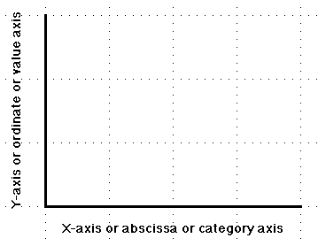
Graph Basics
The graphs considered here are all two dimensional representations of data that could also be shown in a frequency distribution.
The typical graph consists of
A horizontal axis or x-axis which represents the variable being presented. This axis is referred to as the abscissa of the graph and sometimes as the category axis. This axis of the graph should be named and should show the categories or divisions of the variable being represented.

Slide 37
Graph Basics
A vertical axis or y-axis which is referred to as the ordinate or the value axis. In the graphs we will be considering the ordinate will show the frequency with which each category of the variable occurs. This axis should be labeled as frequency and also have a scale, the values of the scale being represented by tic marks. By convention the length of the ordinate is three-fourths the length of the abscissa. This is referred to as the three-fourths rule in graph construction.

Slide 38
Graph Basics
Each graph should also have a title which indicates the contents of the graph.

Slide 39
The Bar Graph
A bar graph’s bars or columns are separated from one another by a space rather than being contingent to one another. Why?
The bar graph is used to represent data at the nominal or ordinal level of measurement. The variable levels are not continuous, therefore the bars representing various levels of the variable are distinct from one another.

Slide 40
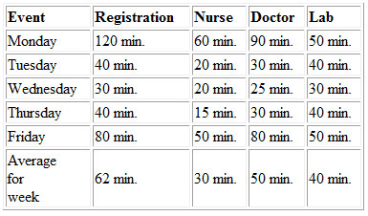
Bar Graph Example Hospital Clinic
A research team collects data over a period of five days by interviewing 100 users. They gather data on waiting times at different points in the clinic: waiting to register, waiting for the nurse, waiting for the doctor, and waiting for the lab. The team creates a table with the results of their work:
What are they doing by breaking things down by day of week?

Slide 41
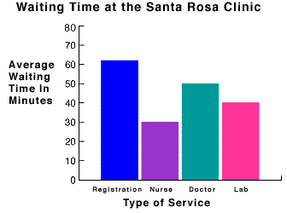
Bar Graph Example
Next, the team draws a bar graph using the data they have collected so they can visualize the waiting time problem.
Looking at the bar graph, the team agrees that waiting time for registration is the biggest problem. They decide to look more carefully into the registration process to better describe the waiting time problem that occurs during registration.

Slide 42
Task - Majors
Make a Frequency Distribution of the undergraduate majors of this class
Turn the frequency distribution into a bar graph

Slide 43
The Histogram
A histogram is similar to the common bar graph but is used to represent data at the interval or ratio level of measurement, while the bar graph is used to represent data at the nominal or ordinal level of measurement.

Slide 44
Clinic Example
The team decides to look at the waiting time data in a different way. They decide to create a histogram that represents the varying amounts of time that users wait before being registered. To create a histogram, they must first go back to their raw data and create a frequency table for the waiting time data they collected.
According to their raw data, the following waiting periods (in minutes) were measured for users at registration: 10, 12, 15, 18, 23, 38, 45, 48, 50, 64, 68, 72, 75, 80, 81, 84, 85, 88, 98, 110, 125, 130, 135, and 140. The team counted the number of data points in the series, and it is 24.

Slide 45
Clinic Example
To organize their data, they first determine the range of the data, which is the difference between the highest and lowest data points: 140-10=130.
Next, they decide on the number of categories they will use to group the data. The manager and the team have 24 data points, so they decide to create 5 categories.
They determine the interval of the categories by dividing the range by the number of categories: 130/5=26 minutes (rounded to 30 minutes).
They determine the range of each interval by starting at 0 and adding the interval each time: 30, 60, 90, 120, 150. So the first interval will be 0-30, the second 31-60, and so on.

Slide 46
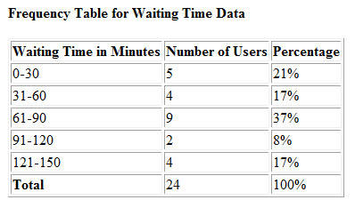
Clinic Example
Now they look at their data and see how many times they observed data points in each interval. Then they construct a frequency table:

Slide 47
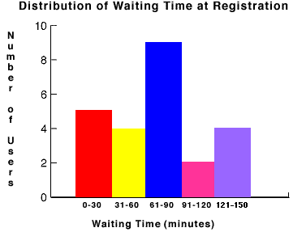
Clinic Example
Next, to create the histogram, the team draws a horizontal axis and vertical axis: the horizontal axis (x), represents waiting time in minutes, and the vertical axis (y) represents the number of users.
For each data category, they draw a rectangle. The height of the rectangle represents the observed number of users in each category.
By looking at the data in a histogram, it is easy to see that the majority of users wait from 61 to 90 minutes for registration.

Slide 48
Task - Heights
Build a histogram from the class heights frequency distribution you already constructed

Slide 49
The Frequency Polygon (Line Graph)
A frequency polygon or “line graph” can be created with interval or ratio data.
A line graph can be created with individual data points or grouped data (using the class midpoints)

Slide 50
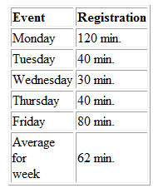
Clinic Example
The team hypothesizes that the waiting time for registration might vary depending on the day of the week. They look at the data they have collected on waiting times for registration:

Slide 51
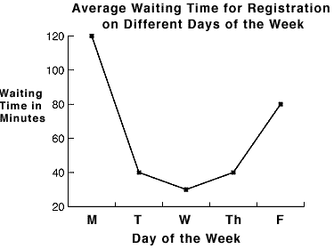
Clinic Example
Next, they decide to create a line graph with this data. The x-axis will represent the days of the week, and the y-axis will represent the waiting time in minutes. They plot the data points on the graph and connect the dots to form a line. Below is the line graph they create:
By observing the line graph, the team can clearly see that Mondays and Fridays are the days with the longest wait in registration, and that Mondays are the worst days for long waits.

Slide 52
Task - Heights
Using your histogram, overlay a line graph
Where do the points go?

Slide 53
Pie Chart
A pie chart is a very simple visual device for conveying proportions
It is used with either interval or ratio level data that has been converted into percentages

Slide 54
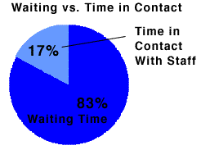
Clinic Example
If the team had collected data on the total time the patient was at the clinic, then they could figure out the proportion of time waiting vs. interacting with a person

Slide 55
Task
Using the majors frequency distribution, create a percentage distribution and a pie chart

Slide 56
Assignment
Tables, Frequencies, Graphs and Charts Exercises (download from class site)
Drawn by hand
In my mailbox by next Tuesday morning

